Slide 1
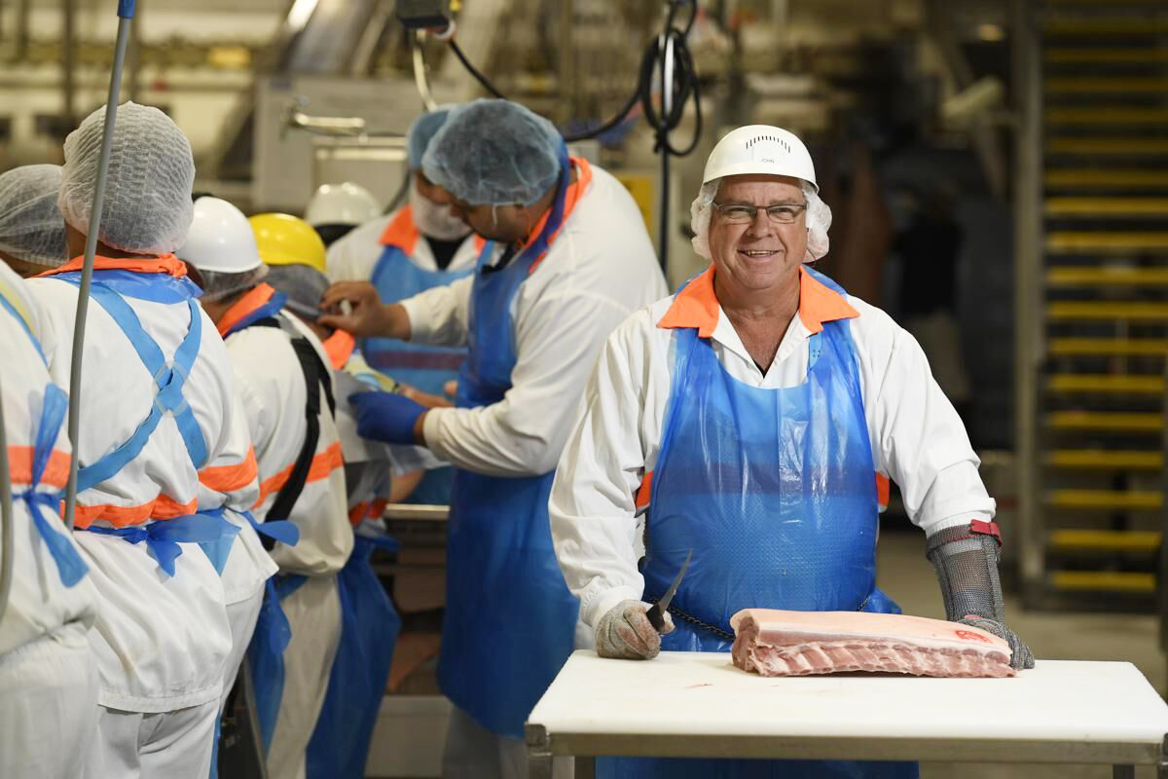
Good Manufacturing Processes
GMP Training

Slide 2
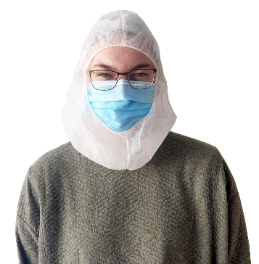
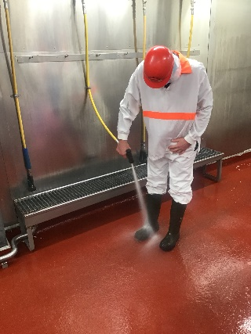
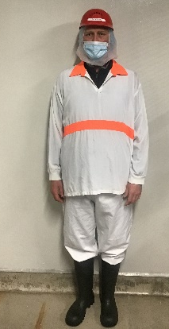
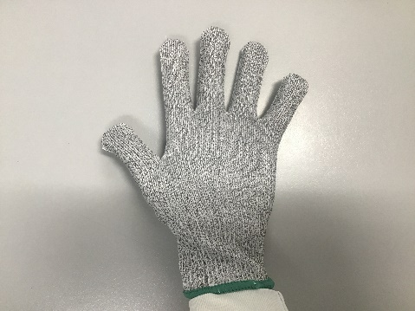
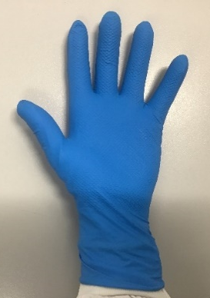
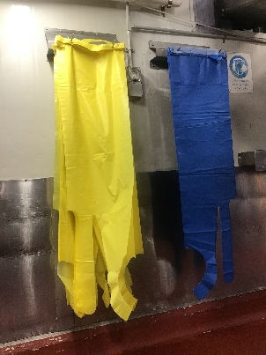
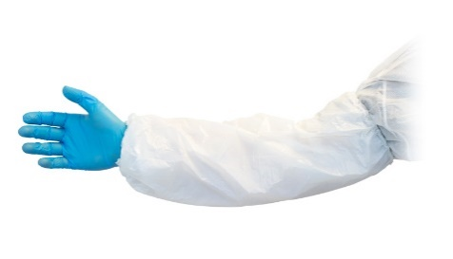
Donning & Doffing Sequence
1. Hair Net/Beard Net,
Face Mask, Balaclava
2. Top, Pants, Boots,
Hard Hat, Earplugs
3. Boot Wash
c
7. Gloves
4. Hand Wash &
Kevlar Gloves
5. Apron
6. Sleeves
Notes:
Hair net, beard net, face mask, Balaclava. Your hairnet mist be applied before collecting your uniform.
Uniform: pants, top, boots, hard hat, attach ear plugs to hard hat. Production staff wear white tops, maintenance high vis green, warehouse orange and cleaners were a red or striped coat.
Boot washing: Use the boot washing station to thoroughly clean the underside and topside of your boots.
Hand wash & sanitisation. You must wash and sanitise your hands with soap for at least 20 seconds. After washing your hands put on your Kevlar gloves.
Apron – yellow or blue. First apply your apron. Be sure to wear the correct apron for your assigned task. Blue aprons are used for pure meat product and a mesh apron is worn underneath and yellow aprons are used for moisture infused products (MIP).
Sleeves - If you work in the packing area or operate machinery, apply your sleeves. Ensure the sleeves are on correctly, by checking if it begins at your wrist and ends at your elbow
PPE Gloves: Finally, apply your gloves and always check they’re free of any rips before commencing work. Your disposable glove should be placed over your Kevlar glove. When dressing down, you repeat this process in the opposite order.

Slide 3
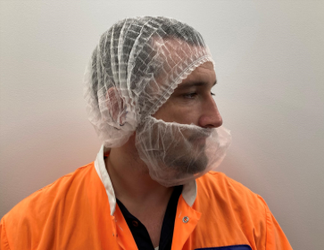
Nets, Mask, Balaclava
Balaclava is required to cover hair net/beard net
Hair net must be covering all hair.
Hair net must be covering ears.
Facial hair must be covered by a beard net.
Notes:
Beanies must be covered by hair net
Anyone un-cleanly shaven must wear a beard net

Slide 4
PPE
Sleeves
Worn by packing and machine operators staff only
Aprons
Blue: Pure meat product, mesh apron underneath
Yellow: Moisture Infused Products (MIP)
Gloves
Disposable glove worn over Kevlar Glove.
Notes:
Important!
Torn PPE must be changed and report to QA and your Supervisor.
PPE must be removed AWAY from open product
PPE stations cane be found near the washroom entrance and packing room entrance.

Slide 5
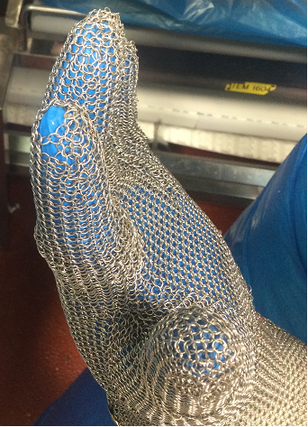
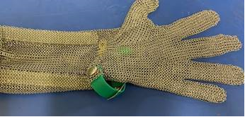
Mesh PPE
Condition
Check the condition of your mesh PPE at the start and end of your shift.
Hygiene
At the start of the shift, Employee gear (including knife, mesh glove, mesh apron) must be sterilized and sanitised, to prevent cross-contamination.
Employee gear (knife, mesh glove, mesh apron) must be washed in the designated wash station with detergent and meat particles must be completely removed.
Notes:
Condition
Before commencing your shift, check the condition of your mesh PPE
You must check the condition of your PPE a the start and end of your shift
If there is any damage this must be reported to your supervisor and QA IMMEDITALEY
Hygiene
At the start of the shift employee gear (including knife, mesh glove and mesh apron) must be sanitized and sterilized to prevent cross-contamination
Employee gear must be washed in the designated wash station with detergent and meat particles must be completely removed.

Slide 6
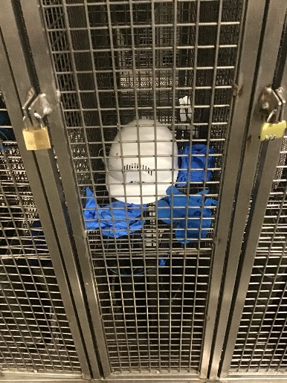
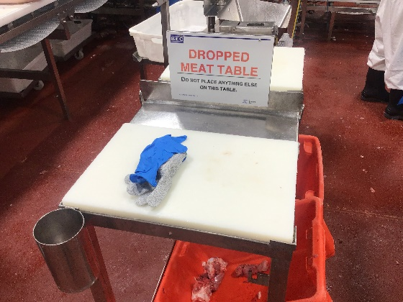
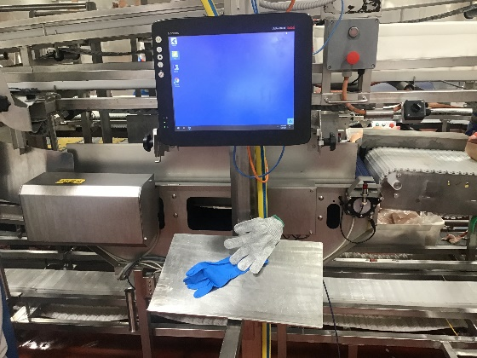
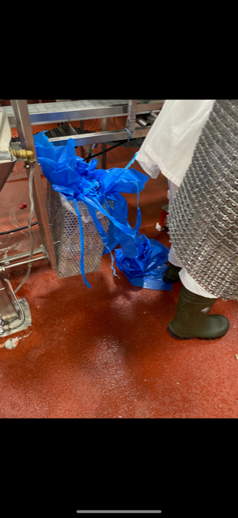
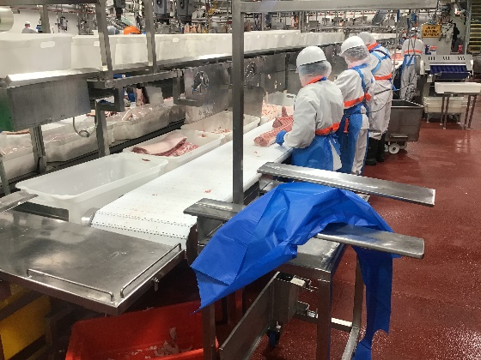
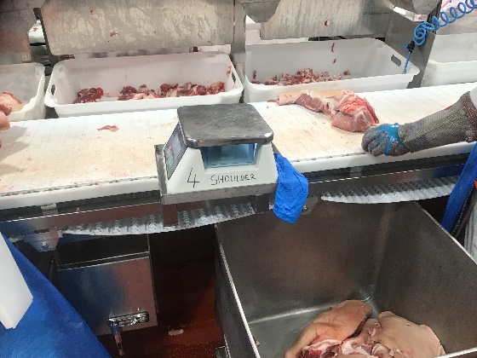
PPE Disposal
Notes:
PPE must be removed when exiting the floor and new PPE is required when re-entering the floor
PPE must be put in the bin, anywhere else is unacceptable!
PPE is not to be left on Drop meat tables, production lines or equipment

Slide 7
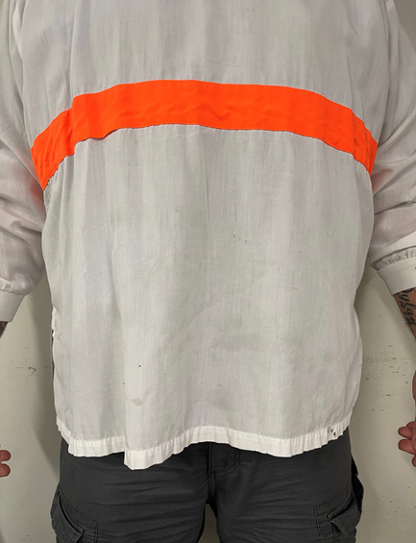
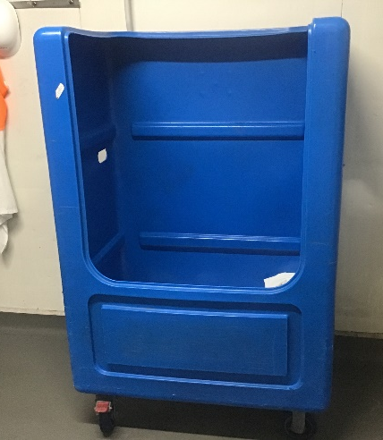
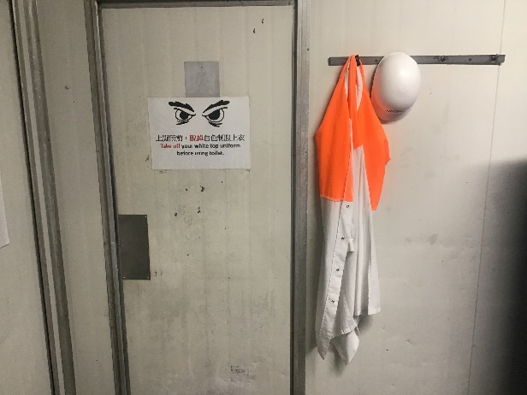
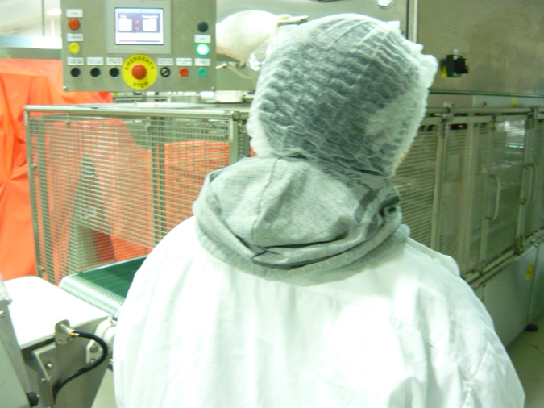
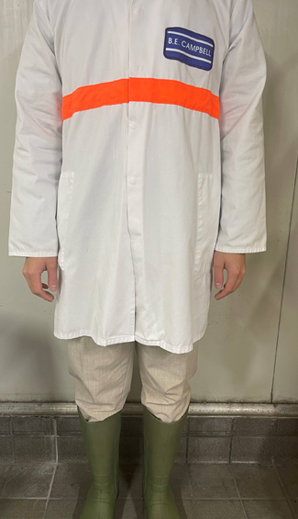
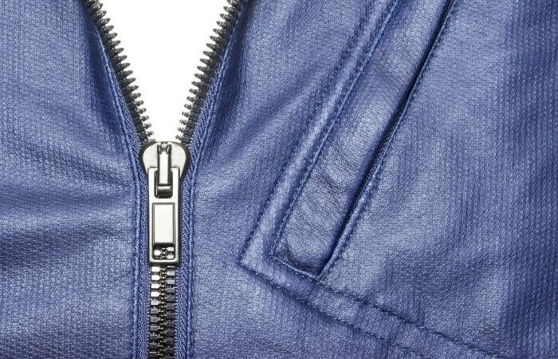
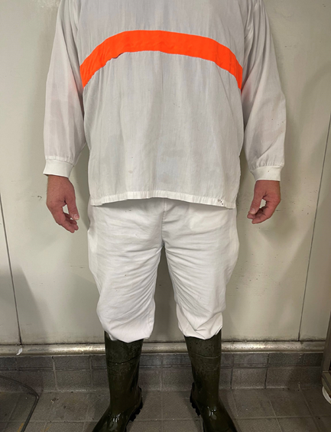
Uniform Rules
Notes:
Dirty Uniforms: Must be placed in the laundry tubs on site, all other areas are unacceptable.
White Uniform top: Cannot be worn while smoking, in the toilets or when outside the factory.
Uniform Hooks: You can find hooks are located outside the toilets and on your locker door to hang your uniform when its not in use. Tops are to be removed before using the toilet.
Street clothes: must be completely covered by your uniform, including jumper hoods.
Zippers: shouldn’t be hanging over exposed meat as this can lead to contamination
Correct uniform: Lab coats are only to be used by QA, Management and Visitors- all production workers must wear white pants and the white top

Slide 8
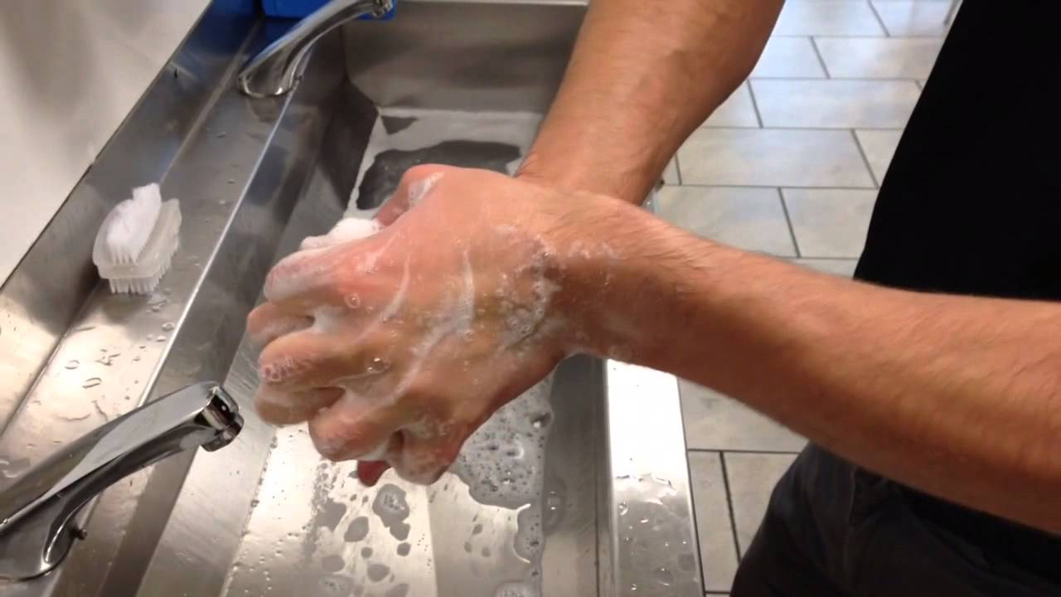
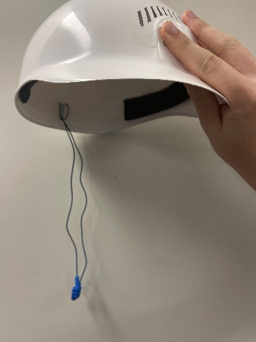
General Hygiene
Notes:
Nail polish and acrylic nails: are not permitted in the factory. Nails must be kept clean and short.
Strong scented perfume, aftershave and moisturiser: is not permitted in the factory. These products can taint our meat
False-eyelashes: are not permitted in the factory.
Chewing gum and spitting: is strictly forbidden anywhere on site.
Hand washing: Boots must be washed each time you enter and exit the factory floor on the top and underside. !!!!Things can get stuck in the tread of your boots and transfer to the factory floor!!!! Your hands must be washed when entering and exiting the factory floor. It is critical to wash your hands after eating, drinking and smoking as these products may contain allergens.
Ear Plugs: Are metal detectable, to ensure earplugs have not fallen out during production and ended up in the food product. It is your responsibility to ensure your earplugs are secured correctly and kept clean.

Slide 9
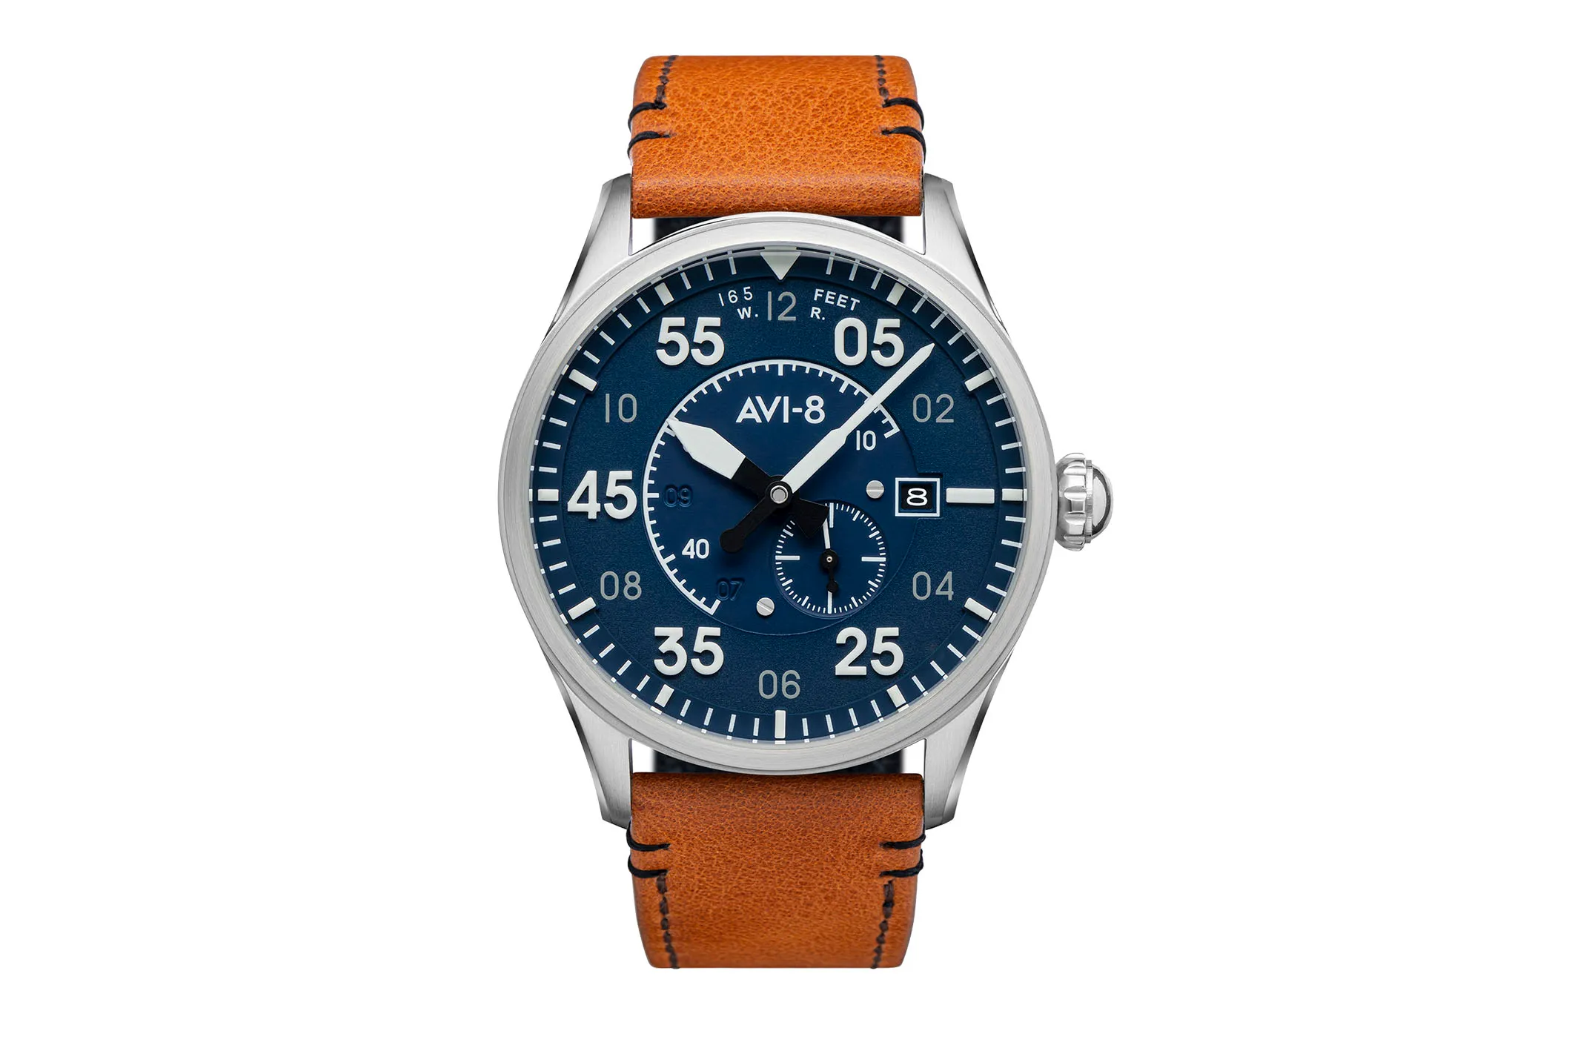
Jewelery
Notes:
All of the following Jewelery is forbidden:
Watches
Chains & necklaces
Bracelets
Earrings including facial piercings
Activity Monitoring watches and apple watches
Rings
Only a plain wedding band may be worn if it has NO stones.

Slide 10
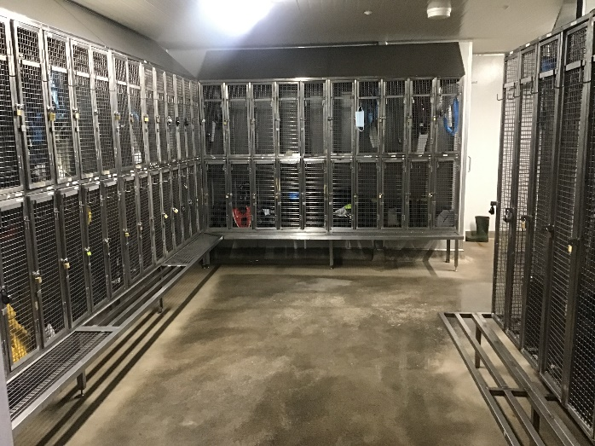
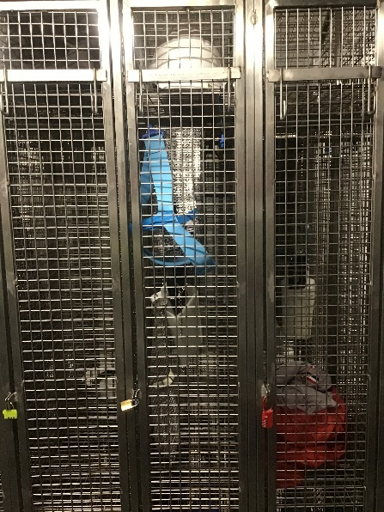
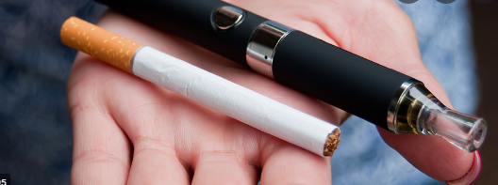
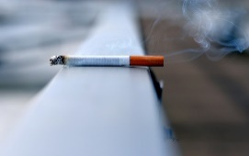
BEC Company Policies
Notes:
Locker rooms: are a communal space that all production staff share. No eating or drinking in the locker rooms or storing food and drink, as this attracts pests. All food and beverages should only be stored and consumed in the lunch room. At BE Campbell we complete random locker inspections to ensure there is no forbidden items in your locker. Uniforms, PPE or equipment from the factory floor are not to be left in your locker or the locker room.
Personal Locker: is used for your own convenience and safety and it is your responsibility to keep the locker clean, tidy and locked. During your shift, your locker should have your clothes, shoes and personal belongings stored. After your shift your locker should have your hard hat on the top shelf and boots on the bottom shelf.
Smoking: Smoking/ Vaping is restricted to the smoking shed ONLY and all butts should be put out in the designated ash trays. Smoking, including the use of e-cigarettes is strictly forbidden on any other part of the BE Campbell grounds, including having them on your person in production or storage areas.
Mobile phones: Phones are strictly forbidden on the factory floor and should be left in your locker as using your phone whilst working is very hazardous and can result in injury. Cracked phone screens can also result in glass ending up in our products, and this could cause serious injury to our consumers. Mobile phone use is strictly limited to maintenance and senior management.

Slide 11
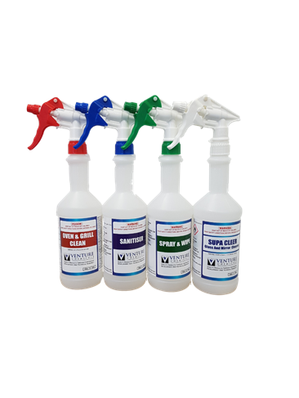
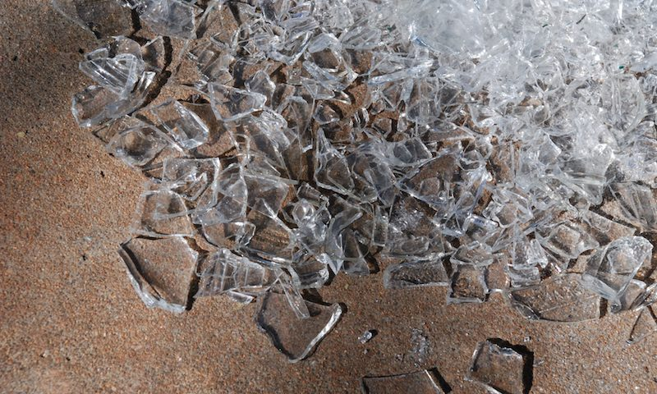
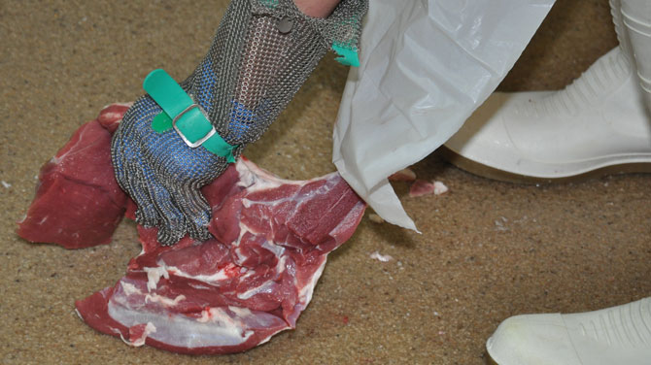
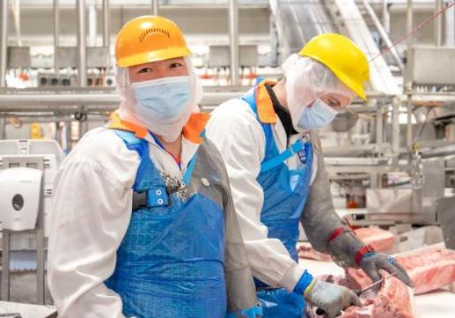
BEC Company Procedures
Notes:
Chemical Usage: Only operators trained in safe chemical handling can use chemicals. Chemicals which have been approved should be used and all spray bottles must be labelled with a tag. Be sure to read the label carefully and check it is the right chemical for the task you are completing before use.
Blocked Drain: In the event there is a blocked drain in the factory a cleaner should be called to unblock the drain. We ask that you refrain from unblocking the drain yourself as this contaminates your PPE and the hose, which will only contaminate our food products. One method we can use to prevent water from pooling is by using the dry cleaning method, to decrease the amount of meat from being hosed down the drains.
Glass & Brittle Plastic: In the case that glass or plastic is found or a breakage has occurred, you must stop the line, isolate the area and notify your supervisor and quality assurance immediately. Our quality assurance team have a glass breakage kit that will be applied when glass or plastic is found in the plant. Blue, metal detectable band-aids should be used for any cuts.
Cleaning & Sanitising: Ensure the are you work in is kept clean and your PPE is washed and stored as per the washing procedure.
Dropped Meat: In the case that raw meat drops on the floor inform your supervisor. They will pick it up and take it over to the dropped meat table to be trimmed and inspected. If the meat is bagged and dropped, the packet must be sanitised prior to being put back on the bench.
Pest Awareness: If you spot a pest in or around the facility inform QA ASAP as this is a food safety risk. QA will take the necessary steps to control the situation.

Slide 12
Critical Control Points (CCP)
CCP1 - Carcase Surface Temperature (Incoming)
CCP2 - Metal Detection
Must be less than 7ºc.
If the temperature is higher than 7ºC, Supervisor & QA to be informed.
Product rejected by the metal detector/ x-ray, must be put back through 3 times.
Supervisor & QA to be informed if rejected on any 1 of the 3 times.
Notes:
CCP Definition: A CCP is a point in our process that if not monitored could result in harm to the consumer

Slide 13
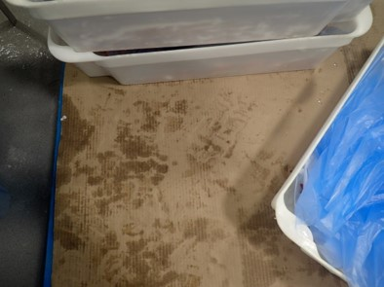
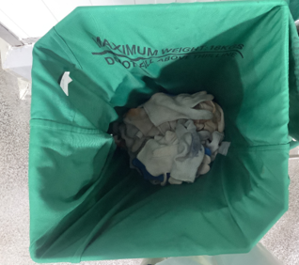
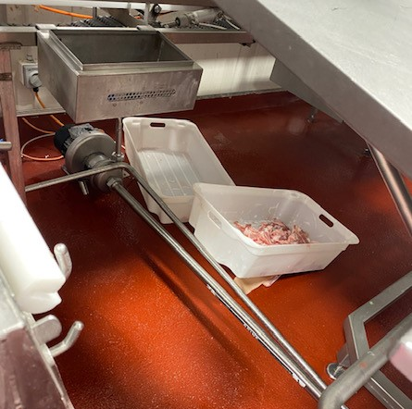
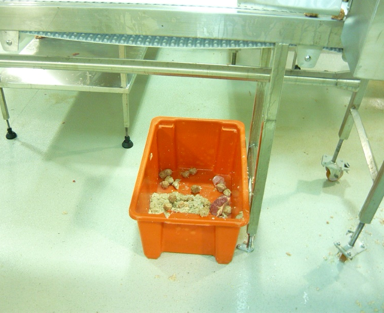
Appropriate Behaviours in Production
Notes:
Do not step on pallet slips. The underside of your boots come into contact with different bacteria's and this is then transferred to the bottom of the tubs, which may be stacked on top of another tub, which increases the risk of contamination
Using your uniform for cleaning is not permitted.
Kevlar gloves must be given to supervisors at the end of your shift for reconciliation.
White tubs are used for edible products and cannot be stored on the floor. Red tubs are used for meat waste and can be stored on the floor.

Slide 14
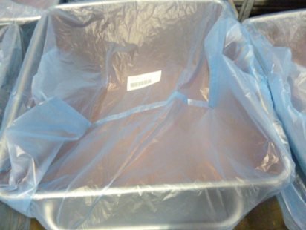
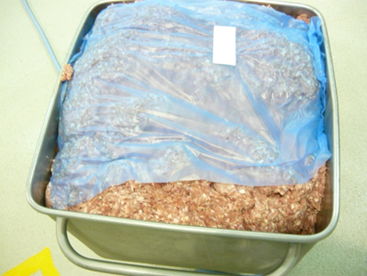
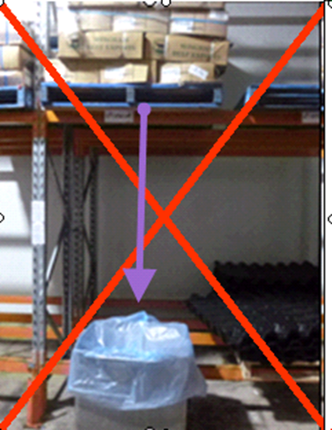
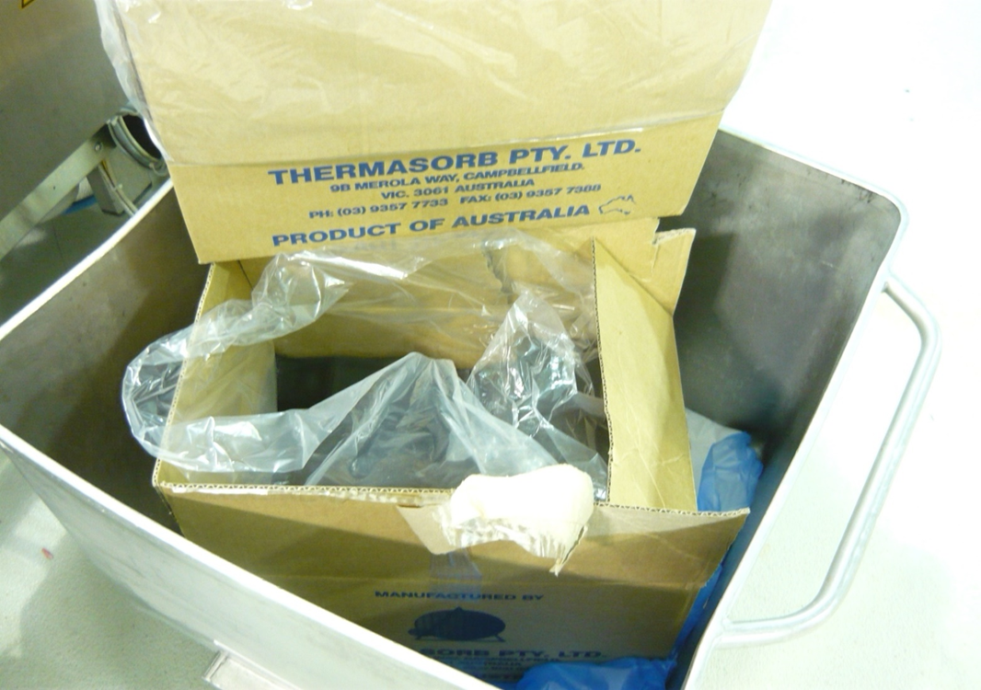
Notes:
S-Tubs
S-tubs must be covered with a liner and labelled with a product code, date and time
Liners should not be ripped and must cover the food completely
Don’t store S-tubs under pallet racks as things can easily fall into the tub
Don’t put rubbish in S-tubs

Slide 15
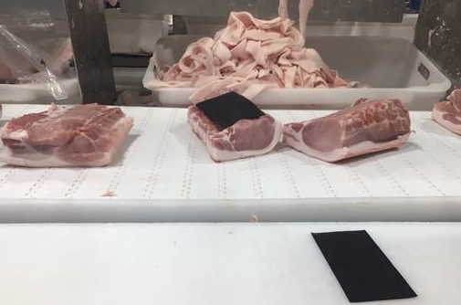
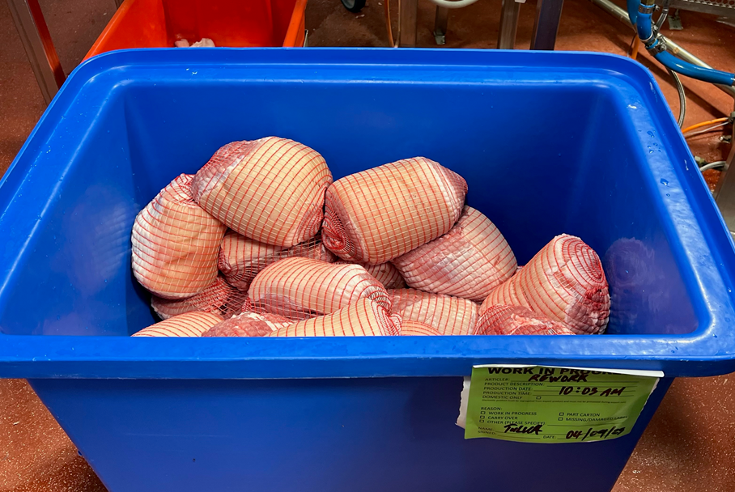
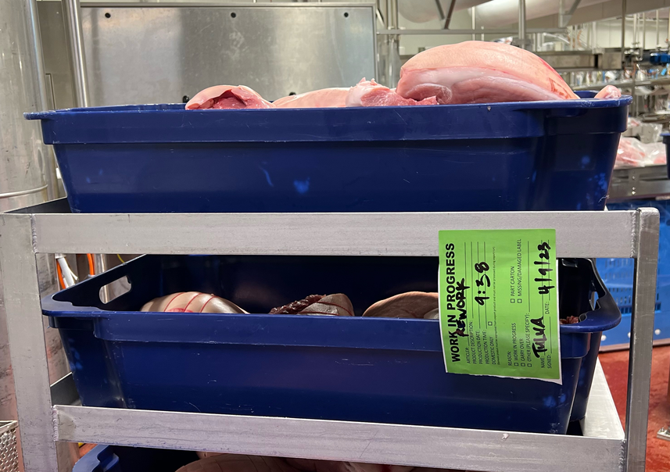
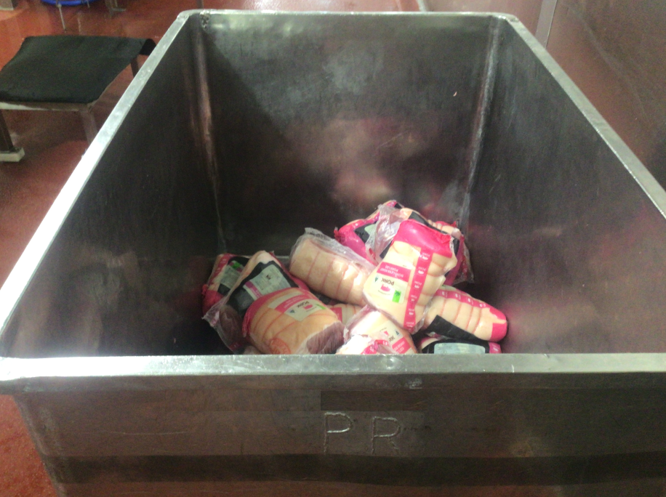
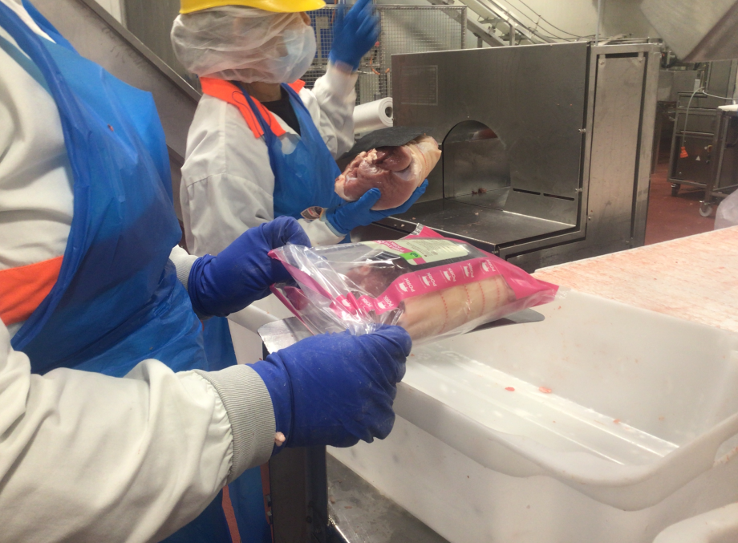
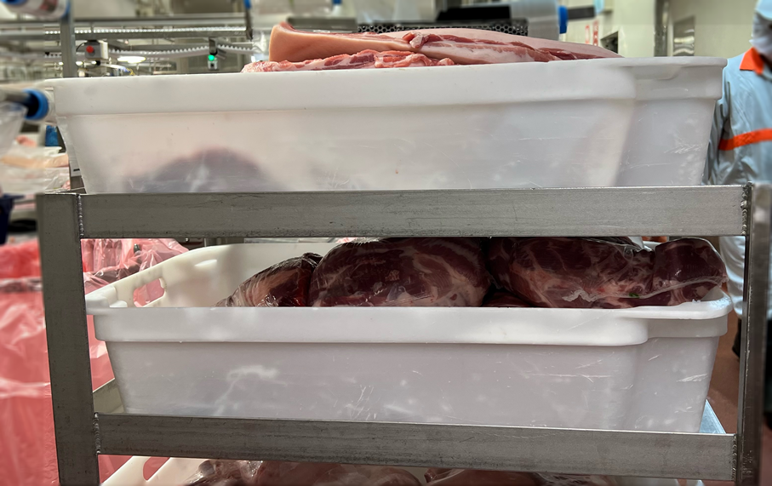
Segregation
Notes:
No strung/netted product on belt
Strung/netted rework should be segregated in blue tub
Bin Color coding –
Blue bins: Strung or netted products
Red bins: is for waste
White bins: for non-strung/netted product
Silver bins: for rework of unstrung/netted product

Slide 16
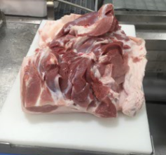
Abscess and Zero Tolerance defects
What if abscess or ZT found during processing
Abscess
1. Stop belt and isolate the product
2. Clean belt with spectrum and warm water
3. Trim affected product
Zero Tolerance
(Faecal matter, Ingesta)
4. Discard contaminated part
5. Change gloves
6. Sterilise knife
7. Clean DMT with spectrum warm water
Notes:
Abscess and Zero Tolerance defects
What if abscess or ZT found during processing
Stop the belt and isolate the product
Clean the belt with spectrum and warm water
Trim affected product
Discard contaminated parts
Change gloves
Sterilise the knife
Clean DMT with spectrum and warm water

Slide 17
Notes:
In pictures:
Spades and squeegees should be stored in their correct spot and not on the ground
Crates must be stacked on pallets and not directly on the ground.
X-ray metal detector cage should be locked at all times. If you see it is unlocked inform QA.
Other’s:
Don’t use scissors to trim meat
Cover all tubs and food product when maintenance repairs are occurring

Slide 18
Notes:
In pictures:
Scales and Bizerba must be cleaned after use
Waste string from stringing machine moved to waste bin and not left hanging on machine
Keep strung and un-strung products separated throughout the process to ensure un-strung product doesn’t become contaminated
Others:
PPE must be changed after touching hoses, bins and strapping and if torn
Report condensation to cleaners, this is a food safety issue and very important
Only utilise site issued stationary. All staples, pins etc. must be removed before entering the floor

Slide 19
Notes:
In pictures:
Make-shift repairs are not permitted, all repairs to be conducted by maintenance
All loose items must be returned to the loose items box. Report damaged and missing loose items to QA
Report any foreign objects or breakages to QA. If you are suspect a product has been contaminated inform QA.
Others:
All rubbish goes in the bins
Surfaces must be visually clean after an operational clean
Excess packaging waste to be disposed of to avoid foreign object contamination
Only tools provided by maintenance can be used on the floor and must be in a tool box

Slide 20
Allergens
What is an Allergen: Food allergens are typically naturally-occurring proteins in foods that cause an allergic reaction in individuals.
What is a Food Allergy: A food allergy is the abnormal response to a normal harmless substance (e.g. milk). This is caused by your body recognising food proteins as harmful. Food allergies can lead to serious illness. Symptoms of food allergies include; rashes, swelling, respiratory problems, anaphylaxis and even death.
Notes:
What is an Allergen: Food allergens are typically naturally-occurring proteins in foods that cause an allergic reaction in individuals.
What is a Food Allergy: A food allergy is the abnormal response to a normal harmless substance (e.g. milk). This is caused by your body recognising food proteins as harmful. Food allergies can lead to serious illness. Symptoms of food allergies include; rashes, swelling, respiratory problems, anaphylaxis and even death.

Slide 21
Allergens
Although at WP we do not have allergens in our products, allergens can still be easily transferred to the product in other ways.
How can you prevent cross-contamination of allergens to our products:
Ensure ingredients in the dry goods store are stored correctly and any spills are cleaned up immediately.
No food items to be brought into production/ warehouse/ maintenance areas.
No PPE or uniform tops to be worn in the lunch room when eating
After meal breaks, ensure you follow the correct hand washing procedures
Allergen Management is EVERYONE’s Responsibility!
Notes:
Although at WP we do not have allergens in our products, allergens can still be easily transferred in the following ways:
Allergens in the Dry Goods Storage Area.
Allergens can be transferred onto your uniform when eating on your break.
Wash your hands and follow the correct procedures to avoid this transfer.
How can you prevent cross-contamination of allergens to our products:
Ensure ingredients in the dry goods store are stored correctly and any spills are cleaned up immediately.
No PPE or uniform tops to be worn in the lunch room when eating
After meal breaks, ensure you follow the correct hand washing procedures
Allergen Management is EVERYONE’s responsibility!

