Slide 1
Using Business Software Applications
Presented by Kerrie Morrison

Slide 2

Learning Topics
Select and Prepare to use Technology
Input and Process Information or Data
Finalise and Store Document

Slide 3
TOPIC 01
Select and Prepare to use Technology

Slide 4


Select and Prepare to use Technology
With the use of technology in workplaces, organisations have been able to increase their productivity and efficiency.
Technology allows easy access to information, and allows work teams to collaborate.
Processes can be achieved in a quick and efficient manner with digital tools, applications, and systems.

Slide 5
Task Purpose and Presentation Needs
There are many types of office technologies, each designed for a specific purpose, and generally requiring application software.
The type of technology and hardware used is determined by the:
Type of Business
Size of Business
Notes:
There are many types of office technology. Each is designed for a specific purpose. Almost all tasks that the staff are required to do will use some type of business technology, including hardware and software applications. There would be almost no business today that wouldn’t have some type of business technology being used.
The size and type of the office operation will determine the types of office technology in use.
In conjunction with certain types of business technology is also the requirement for application software. The most common types of business software applications include:
Word processing
Spreadsheet applications
Database
Slide presentation software
Desktop publishing
Email applications

Slide 6
Task Purpose and Presentation Needs
Common types of business technology include:
Computers
Computer Peripherals
Telephone Systems
Photocopiers and Scanners
Notes:
The most common types of business technology found include:
Computers – Used to perform various tasks and can hold enormous volumes of information
Computer peripherals – This includes keyboards, mouse and trackpads
Telephone systems – Complex telephone systems can be used to speak with both internal and external stakeholders
Photocopiers and scanners

Slide 7



Select Relevant Technology and Software
There are many word processing and spreadsheet applications on the market, however the most popular for word processing and spreadsheeting are Microsoft Word and Microsoft Excel. Microsoft PowerPoint is the most used presentation software application.
Notes:
There are many word processing and spreadsheet applications on the market that are used in many workplaces across the globe. The two most common business software applications for word processing and spreadsheet applications are Microsoft Word and Microsoft Excel.
For electronic slide presentation, Microsoft PowerPoint is the most used software application. PowerPoint 2019, Word 2019 and Excel 2019 were upgraded to be provided in the new Microsoft Office 365 package. This a subscription-based software application service. If you are working in an office, your employer may have an Office 365 subscription.

Slide 8


Identify Presentation Requirements
The standard letter is the most commonly printed document in business.
In many businesses the office will have a supply of printed letterheads.
Businesses will also have an electronic
version of the letterhead as a template.
Notes:
When thinking of word documents most people think of business letters. However, there are several documents that are used in the office environment.
The standard letter is the most commonly printed document in business. In many businesses the office will have a supply of printed letterheads, and these are inserted into the printer for letters to be printed on them.
The benefit of using letterheads is that the paper quality is often better and the logos, contact details and colour schemes are already placed on the letterhead. The disadvantage is that the letterheads can only be used to produce hardcopy letters. To solve this problem the business will also have an electronic version of the letterhead as a template.
The logos, contact details and colour schemes are elements of the template, as are the text fields.
The advantage of letterhead templates is that they can be produced and sent electronically as well as printed out. Also, word processing applications such as Microsoft Word have various styles of letterhead templates as part of the application.

Slide 9
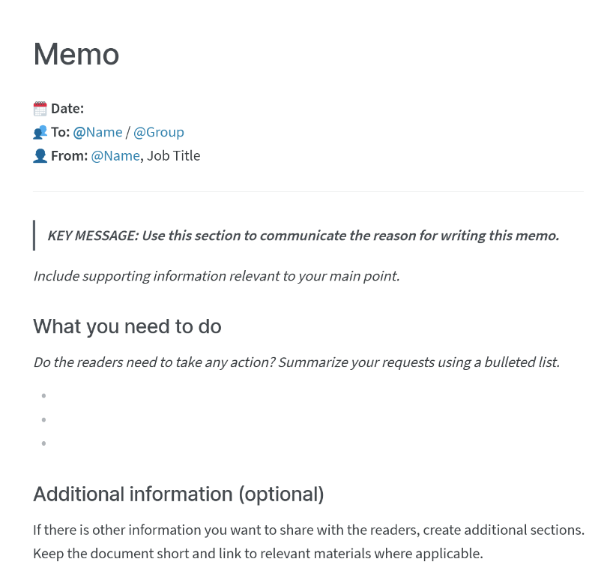

Identify Presentation Requirements
A memorandum (memo) is generally an internally distributed document that is short and concise. It commonly contains:
Who it is to and who it is from
Who it may be CC’d to (receiving a copy)
Date of memo
Subject line
Body of text
Signature
Notes:
A memorandum, commonly known as a memo, is generally an internally distributed document. A memorandum is a short and concise document and is written to get a message across quickly. These are commonly used for communicating a quick update to internal staff. Most businesses use a lot of memos, for a wide range of purposes.
A common layout for memos contains the following components:
Who it is to
Who it is from
Who it may be CC’d to (who is receiving a copy)
Date of memo
Subject line
Body of text
Signature

Slide 10

Meeting Documents
Workplace meetings vary from formal board meetings to informal catch ups between staff. The first common meeting document is the ’meeting agenda’.
A meeting agenda should list aspects like the meeting focus, date, time, duration and location. It should also list the meeting Chairperson (the person who organised the meeting), any speakers and the attendees.
Notes:
Workplace meetings vary from formal board meetings to informal catch ups between staff. The first common meeting document is the ’meeting agenda’.
The meeting agenda should list the following:
Focus or subject for the meeting and meeting date, start and end time and location.
Chairperson (who called the meeting), attendees and speakers.
Items or documents to bring (if applicable).
Topics to be covered, details of each and time frame for each topic.
Additional information or comments.
A good meeting agenda will give the reader a sense of the purpose and direction of the meeting.

Slide 11

Meeting Documents
Another common meeting document is the ‘meeting minutes’ that records who attended the meeting and provides an important record of what was discussed.
A meeting minutes document will also include any decisions that were made within the meeting, if there were any unresolved topics/issues and what will be discussed at the next meeting.
Notes:
The next common meeting document is the ‘meeting minutes’, which includes:
When and where the meeting was held
Who chaired the meeting (call to order)
Who attended the meeting (roll call)
What was discussed at the meeting
What decisions were made at the meeting
What topics were discussed, but not finished (open topics/issues)
What new topics were to be introduced at the next meeting (new business)
The time the meeting finished
Most formal meeting documents are kept on record for future reference or evidence and are generally considered to be legal documents. ‘Board meeting minutes’ are especially important and are legally required in public companies.

Slide 12

Identify Presentation Requirements
Newsletters provide customers, clients, shareholders and the general public information about an organisation. Newsletters communicate:
New products/services
Events
Financial Information
General newsworthy items within the organisation
Notes:
Many companies produce newsletters. These are business documents that are generated often to provide customers, clients, shareholders and even the general public information about the organisation.
The newsletter could include information about:
New products/services
Events
Financial information
Other general newsworthy items within the organisation
The common newsletter layout is two to three columns per page, text fully justified, text hyphenated and supported with graphics, photos and illustrations.

Slide 13
Reports
There are two common types of reports:
Short
Reports
These are generally used for meetings, presentations
and training sessions.
Technical Reports
These are comprehensive and allow different forms
of information to be compiled into one document.
Notes:
There are two common types of reports:
The first is short reports, which are are structured with a centred title and the name of the author of the report. The report is broken up into subheadings, with simple and concise text under each. These reports are normally used for meetings, presentations and training sessions.
The second is a technical report. The structure of a technical report is far more comprehensive and allows different forms of information to be compiled within the one document.
This information could include:
Design drawings
Analysis, calculations, spreadsheets models
Graphs, charts, photos, illustrations
Descriptive narrative, summaries, minutes
Conclusions, recommendations, proposals

Slide 14

Presentation Documents
Presentation documents are used for many applications, including:
Internal notice posters
Promotional flyers
Product ‘spec’ (specification) sheets
Product brochures
Notes:
Presentation pages are used for many applications. They include:
Internal notice posters
Promotional flyers
Product ‘spec’ (specification) sheets
Product brochures
Word processing software applications offer many tools that allow to insert pictures, illustrations and graphics as well as artful lettering, wide range of colour palettes and border designs.

Slide 15
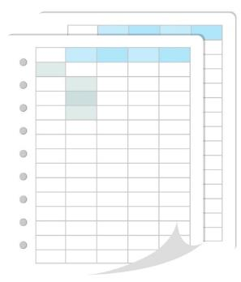

Spreadsheets
Spreadsheets have wide usage in the office environment and across many industries.
Some of the common uses include:
Basic accounting
Inventory
Customer lists and database
Employee rosters and payroll
Notes:
Spreadsheets are powerful computer applications that have wide usage in the office environment and across many industries. Spreadsheets are also used with other programs, such as word processing, desktop publishing and other accounting programs. You can add graphics and pictures to support the information contained in the spreadsheet.
In an office environment you will encounter many uses for spreadsheets. Some of the common uses include:
Basic accounting
Inventory
Customer lists and database
Employee rosters and payroll
The flexibility of a spreadsheet software application is enormous. They not only hold data but have significant formatting features (column and row sizing, shading and colouring), perform complex calculations, sort data, create graphs and charts of all types and much more. The design of a spreadsheet needs to consider the type and amount of information required to provide to the reader. This means the data needs to be organised in the spreadsheet to present information logically and concisely to the reader. Furthermore, the data variables must be considered when designing the spreadsheet.

Slide 16
Identify Presentation Requirements
Any presentation must be targeted towards the audience it is intended for.
Your purpose in developing a presentation to a specific audience is to inform, persuade, or entertain.
Know as much about the audience and their interests as possible.
Notes:
Any presentation must be targeted towards the audience it is intended for. You should know as much about the audience and their interests as possible. This is so you can tailor your slide show to their needs and to better ensure a positive reception from the presentation.
Your purpose in developing a presentation to a specific audience is to inform, persuade, or entertain the audience. Your motivation is to get satisfaction from expressing your ideas and getting recognition or positive response from the audience. The choice of presentation medium is made after considering the type and location of your audience and if it is you or another presenter fronting an audience.
What everyone wants to avoid is a PowerPoint slide presentation that is badly designed or is totally ineffective. If you pay attention to these three concepts as you put the visuals together, the end product will be effective. You should aim to:
Make it big so everyone can see it
Keep it simple so the presentation does not look cluttered and messy
Make it clear so the message is fully understood

Slide 17


Identify Audience Requirements
The audience your document will be forwarded to or viewed by will affect the tone, formatting and design.
The audience could include:
Management
Other staff
Customers/Clients
External stakeholders
Notes:
The audience your document will be forwarded to or viewed by will affect tone, formatting and design. The audience could include:
Other staff
Management
Customers/clients
Shareholders
Professional associates such as accountants, lawyers etc.
Banks and other financial institutions
Government departments
Industry associations
Knowing the audience is critical. The style of the document or spreadsheet, how the document/spreadsheet is structured and presented, as well as the tone of the language used in the documents can be quite different from one category of audience to another.
It is recommended that during development, you look back at similar documents or presentations to see the tone and formatting or design and follow it to maintain consistency.
Many word documents are accompanied by spreadsheet attachments, so this too needs to be considered. Many presentations have accompanying handouts. These can be word processed documents, spreadsheets or both.

Slide 18

Identify Presentation Requirements
A presentation may be delivered via:
A desktop/laptop computer
A projector
Disc or storage device
Website
Email
Notes:
Once a slide show has been assembled, there are many ways to present the information to your selected audience. They include:
On a desktop computer
On a laptop computer
Through a projector
Through a data monitor
On a CD/DVD or another type of storage device
On a website
By email
The choice of presentation medium is made after considering the type and location of your audience and if it is you or another presenter fronting an audience.

Slide 19
Identify Audience Requirements
You should understand and follow policies and procedures when producing documents and presentations. These are generally created using the following:
Style guides
Templates
Storage and filing procedures
Notes:
It is important that an office staff member understands and follows the policies and procedures of the business when it comes to producing word processed documents, spreadsheet documents and slide presentations.
Some of those policies could cover:
Content relating to unauthorised communication of sensitive financial or product information
Content that has the potential of breaching Australian privacy laws including staff and customers/clients
Content that has the potential of breaching Australian copyright laws
Content that is deemed to be discriminatory or offensive
Offers, quotations or agreements not authorised by management
These policies also include any attachments to the documents that are covered by those policies. Other organisational policies relating to the use of software applications can include:
Style guides – There may be design/style policies advising on colours, layouts, logos etc. These are required to be followed when designing and developing documents.
Templates – There may be document templates for employees to use when designing and developing a word-processed document, a spreadsheet or a slide presentation.
Filing – There are often policies and procedures on how and where digitally produced document and presentation files are named and stored.
It is important that all policies and procedures relating to the production of word-processed documents, spreadsheets and slide presentations are learnt, fully understood and followed.

Slide 20
Adjust Workspace to Suit Ergonomic Requirements
‘Ergonomics’ refers to a work area design where duties can be performed efficiently and without risk of injury. An ergonomic desk setup includes:
Notes:
Employers are required by WHS law to provide safe working conditions to all employees, including those that are working at desks using computers. In almost all cases, staff that work in an office will be at a desk which will have a computer monitor, keyboard and mouse on it. Employees working at desks for long periods are susceptible to many types of injuries.
An ideally designed workstation would include:
Workspace
Peripherals close to workstation.
A keyboard with correct placement on the desk.
Furniture
An ergonomically adjustable chair.
Desk that allows upper arms to be at right angles to the keyboard.
Equipment
An appropriately sized monitor
An ergonomic mouse
In almost all cases, staff that work in an office will be at a desk which will have a computer monitor, keyboard and mouse on it.
Employees working at desks for long periods are susceptible to many types of injuries.

Slide 21
Adjust Workspace to Suit Ergonomic Requirements
In order to create a safe and productive working environment, with an adherence to meeting ergonomic requirements, steps should be taken to ensure there is:
A reduction in excess noise
Quality air with a lack of pollution
Effective ventilation
An appropriate temperature
Notes:
Noise in an office environment can come from a wide variety of sources. Some could include printers, photocopiers and staff conversing. External sources of noise can be outside vehicle traffic, construction work or airplane traffic. Although most noise in an office environment would not damage your hearing, it can be distracting and cause stress.
Indoor air quality is an increasingly important issue in the work environment. An inadequately ventilated workplace or poorly designed ventilation system can lead to the build up of a variety of indoor air pollutants. Air pollutants can originate within the building or be drawn in from outdoors. Examples of air pollutant sources that originate outside a building include pollen, dust and fungal spores and vehicle exhaust. It is very important that the workplace is a well-ventilated workplace. A good ventilation design will distribute air uniformly to each area and should focus especially on areas with office machines.
Excessively high or low temperatures in the workplace can also lead to reduced productivity. High temperatures have been associated with fatigue, lack of energy, irritability, headache and decrease in performance, coordination and alertness. The general recommendations for indoor temperature are between 20C-25C and the humidity between 40 – 45%. Relative humidity above 50% is not recommended because it can promote mould growth.

Slide 22
Adjust Workspace to Suit Ergonomic Requirements
Resources kept in an office/work environment should be within
easy reach and not require anyone to twist or reach.
Repetitive Strain Injuries (RSI) occur when a part of the body is repetitively performing a particular movement.
Allowing adequate rest periods reduce the likelihood of RSIs
and other fatigue-related injuries.
Notes:
A workstation will require a level of consumables/resources. These can be kept at the workstation or in another location in the office/work environment. The most efficient option is to have a workstation fully resourced. It is important though that the items are within easy reach and you do not have to twist and reach for items while at your desk. This can cause problems in the back and neck. However, if you store your resources away from the desk, it forces you to get up and walk more.
Equipment resources, especially ones that are shared, should be well away from your desk. Equipment, such as laser printers and photocopiers, can emit fumes. Photocopiers, printers and fax machines can cause distractions to those working nearby and can reduce efficiency.
‘Repetitive Strain Injury (RSI)’ is an injury that is often experienced by office workers. RSI can occur when an employee who is using a mouse to do computer work begins to feel pain in the wrist, shoulders and neck. To avoid this, employees should be allowed regular breaks away from the computer and in some cases be assigned a different task for a period of time.

Slide 23
TOPIC 02
Input and Process Information or Data

Slide 24

Input and Process Information or Data
Information and data gathered can be input into a document in a software program.
Software programs allow users to collate and present information, and collaborate with others.
Data can be shared between both individuals and teams.

Slide 25

Input and Process Information or Data
The person tasked with creating work documents needs to be clear on what information is required.
Information/data entered into documents should be accurate and complete.
Data should be entered into the application, according to the organisational requirements. This might include using a workplace template or style guide.
Notes:
Whether it is a word-processed document, a spreadsheet document or a slide presentation – the person tasked in creating the document needs to be clear on what information will need to be included. Even the simplest of documents or presentations can cause significant issues if the information and/or data is inaccurate or incomplete.
Data should be entered into the application, according to organisational requirements. This might include using a template or style guide.

Slide 26
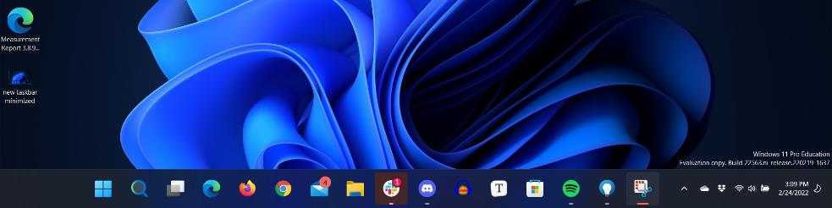
Work Document Applications
Work document applications such as Microsoft Word, Excel and PowerPoint can be accessed from the:
Start Menu
Desktop Shortcuts
Taskbar Shortcuts
Notes:
A powerful feature in Windows is the shortcut facility. Did you know that when Microsoft Word (Word), Microsoft Excel (Excel) and Microsoft PowerPoint (PowerPoint) was loaded onto your PC, it would have likely created a shortcut for each on the bottom main Windows taskbar.
You can also create your own shortcut and place it on the desktop. These shortcuts are what you use to open Word, Excel and PowerPoint.
Generally, when you open each of these applications, you will likely choose a ‘Blank document’. This is where you place information (data) to create your document.
At the top of the window, you will see a ‘ribbon’. This is where you can access all the tools and features of the application.

Slide 27
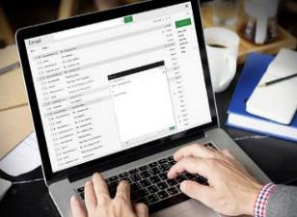



Drafting and Proofreading Documents
The drafting stage is the most important.
Drafting allows content to be reviewed for accuracy.
Documents should be checked and amended.
Review documents until accurate and complete
Notes:
In most business environments, documents go through multiple stages and one of the most important is the ‘drafting stage’. This refers to a stage where the document is nearing completion and the information, data and content is reviewed by the most appropriate people. The document is called a ‘draft document’ or the slide presentation is called a ‘draft presentation’.
This drafting stage allows those reviewing and checking the documents or presentations to ensure that the information, data and/or content is accurate and complete.
With some applications such as a spreadsheet application, there may be formulas that are presenting wrong calculations. These formula faults need to be located and addressed. In most cases, there will be some changes required and this allows those creating the documents or presentations will be requested to make amendments well before the documentation or presentations are finalised.

Slide 28
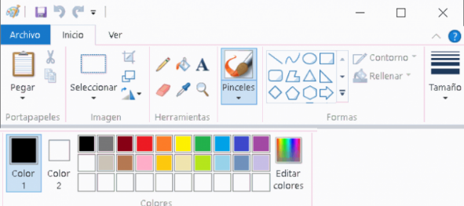

Formatting Information and Data
Formatting documents can include:
Font style
Headings styles
Margins
Header and footers
Colour schemes
Spreadsheets may also require column,
and cell formatting.
Notes:
Generally, business software applications have formatting features and functionality that improves the presentation of the information, data and content. In the Microsoft Office applications there are ‘tool ribbons’ that contain a number of formatting tools.
Formatting of documents can include:
Font style
Headings styles
Margins
Header and footers
Colours
Spreadsheet formatting can include:
Column and row labels
Cell formatting such as number, currency, text etc.
Inserting charts
Inserting graphics
Choice of fill colours
Slide presentation formatting can include:
Heading design
Font styles
Animations
Inserting graphics

Slide 29
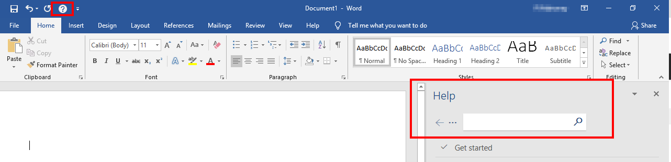
Formatting Information and Data
Business software applications all have help functions which are generally accessed by clicking on a ‘Help’ tab on the tool ribbon.
Notes:
There are times when a person using a business software application runs into problems and needs some basic help to resolve those issues. Therefore, business software applications have ‘Help’ functions.
They are generally located on the tool ribbons and are either accessed by clicking on a ‘Help’ tab on the tool ribbon, or with Microsoft applications and many others, using the F1 function key (PC).

Slide 30
TOPIC 03
Finalise and Store Document

Slide 31
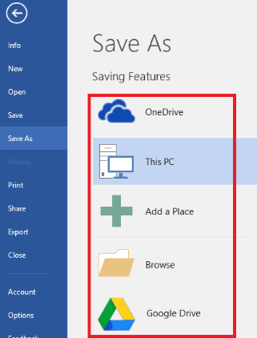

Finalise and Store Document
The final step when creating a document or presentation is naming your document and storing it.
Both tasks require following organisational requirements.
Ensuring your file is named and stored appropriately allows it be accessed easily by others in the organisation.

Slide 32
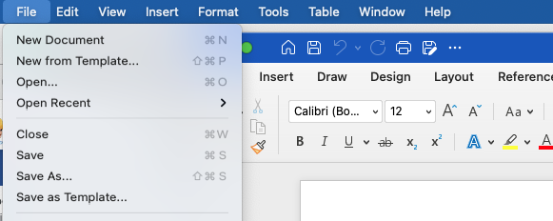
Reviewing, Editing and Preparing for Storage
It is recommended that files are saved regularly as they are created and while being edited.
Notes:
It is highly recommended that files are saved regularly as they are created and while being edited. This prevents losing information or content, should there be a power failure or computer problem.
Most newer applications have a ‘recovery’ feature in the event of a power failure. However, it is best practice to save files while creating, editing and when finished.
The ‘Save’ button on most applications is accessed by selecting the icon at the top of the screen, by selecting ‘Save’ from the ‘File’ menu tab, or by using the keyboard short cut Ctrl + S in Windows or Command + S on Mac.

Slide 33
Naming and Storing Documents
When a document is saved for the first time, create a file name and select a file directory where the document will be saved.
Organisations have policies and procedures to follow regarding:
Where files
are stored
File naming conventions
Notes:
When a document is saved for the first time, the application asks for a file name and a file directory where the document will be saved. This directory can be on the local hard drive, an external drive such as a USB Flash drive, or network/cloud drives.
Organisations generally have policies and procedures to follow regarding saving files. Before saving the file, it should be noted what the organisation requires in this regard. Often, businesses will have a set procedure when it comes to naming files. This is called internal naming conventions.
They are developed to find files quickly within the computer filing system. Again, it would be important to learn if the office has such naming conventions in place.

Slide 34
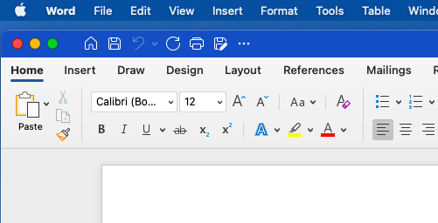
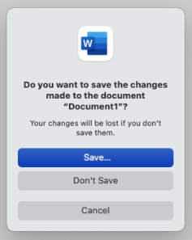
Naming and Storing Documents
Once a file is saved and no longer require the software application, it should be closed to prevent further unwanted edits or data loss.
To exit most applications, simply click on the ‘X’ in the top corner.
Close or Exit
Notes:
Once a file is saved and no longer require the software application, it should be closed to prevent further unwanted edits or data loss.
In most applications, to exit the application you simply click on the ‘X’ in the top right-hand corner, shown in this example.
If for whatever reason the file had been forgotten to be saved, a warning window will appear to prompting a save first and the once this is done the application will safely shutdown and the data is not lost or damaged.

Slide 35
Lesson Summary
Key Learning Points
Any presentation must be targeted towards the audience it is intended for. You should know as much about the audience and their interests as possible.
Software programs allow users to collate and present information and collaborate with others.
business software applications have formatting features and functionality that improves the presentation of the information, data and content.
Ensuring your file is named and stored appropriately allows it to be accessed easily by others in the organisation.

Slide 36


